Slide 1

Post 16/18 Options
Gap Year
T Levels ?
A Levels ?
College ?
BTEC/AAQ ?
Specialised College ?
University
School 6th Form ?
Apprenticeships ?

Slide 2



Developed by Industry.
17 Russell group Universities accept them at present.

Slide 3
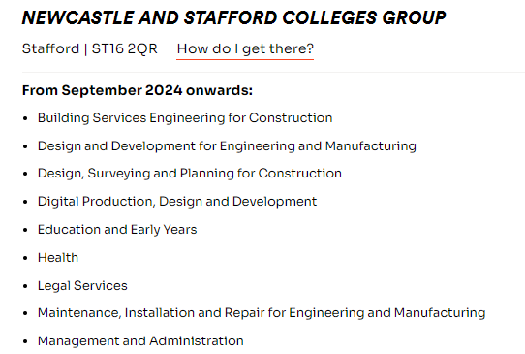
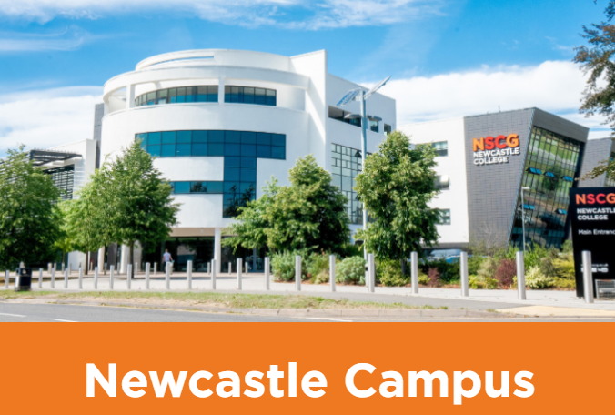
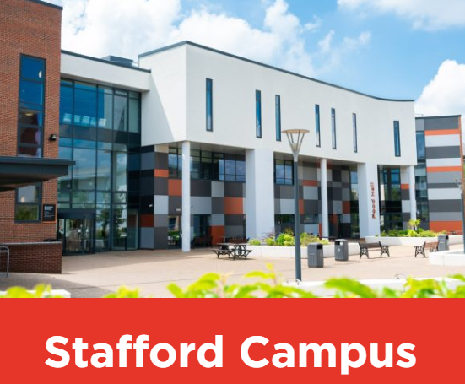

Slide 4
BTEC /AAQ`s Watch this space
Guide to the post-16 qualifications landscape at level 3 and below for 2025 and beyond - November 2023 (publishing.service.gov.uk)
Vocational subjects - This is all up for review and Alternative Academic Qualifications are being looked at by the Government with BTECs being replaced or redundant
The Governments preferred route will be A levels and T levels with attributed qualifications for pupils at level 1 or 2.
Caution – This could change!

Slide 5

BTEC Level 1/2 Tech Awards
Currently in school we offer:
Travel & Tourism, Health & Social Care, Music Practice, Digital Information Technology, Enterprise
BTECs 2014-2023 v BTEC 2024 onwards
 | BTECs 2014 - 2023 | BTECs 2024 onwards
Internal Assessment | 60 – 75% Coursework | 60% Controlled Assessment (each assessment 6 – 15 hours)
External Assessment | 25 – 40% Exam | 40% Exam (except Music - 23 hours assessment)
Assignments for Internal Units | Set by the centre | Set by the exam board
Grading method | Assessment criteria (grades) | Marking grids (marks)
Sampling / Moderation | Marked by centre & sampled | Marked by centre & moderated
When students complete work | During and outside of lessons including for homework | During timetabled sessions only Notes/preparation for homework
Key points when advising students
BTEC Level 1/2 Tech Awards are vocational/linked to the world of work and can have different assessment methods.
No longer have coursework but the assessments are still spread across Y10 & 11.
As Level 1/2 qualifications, they are available to all students, and are no easier than GCSEs.

Slide 6


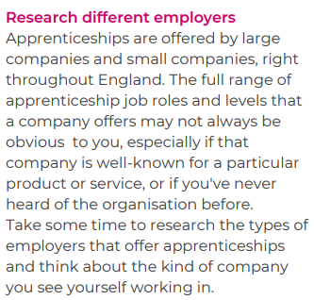
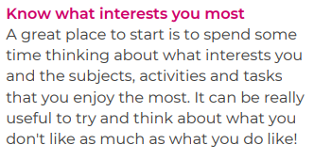

It is not an easy route BUT can be the best route for many !!

Slide 7

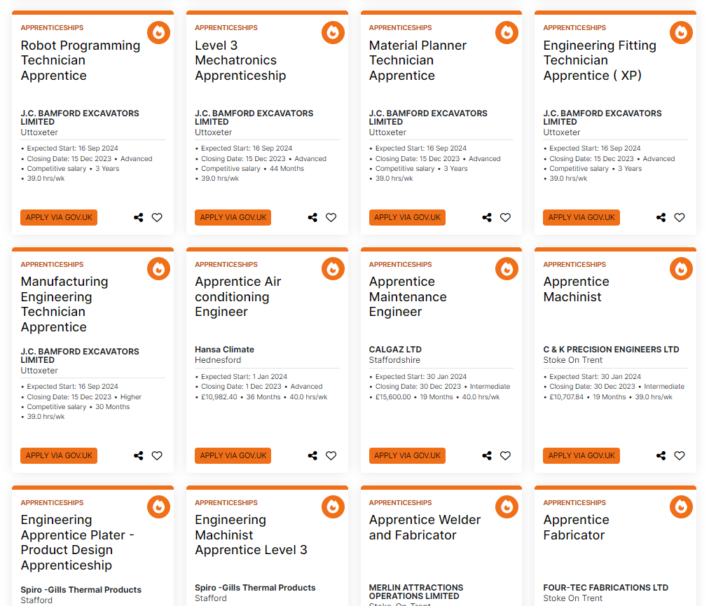

Slide 8

6th Form & A Levels
All the Stafford school Sixth Forms are an integral part of their school’s educational journey for students.
Between them, and individually they have over 20 years of experience in delivering excellent level 3 courses
and supporting students to achieve their full potential.
We have highly skilled, graduate teachers and together with the Head of Sixth Forms and pastoral
teams, they ensure that you can access a balanced range of courses and study them in a supportive
learning environment.
We pride ourselves on being able to offer small group sizes in the majority of
our courses. This offers a personalised learning environment encouraging you to reach your full
potential.
We have access to a wide range of enrichment activities to suit your interests, skills and needs. These
extra/super curricular activities will help you go onto appropriate destinations after you leave the Sixth
Form, whether it is a degree, high level apprenticeship or employment.

Slide 9

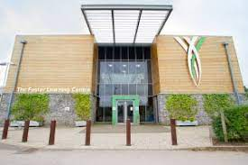
Other Options :

Slide 10
POLICE
Currently there are 3 entry routes , although as of next year there will be 4.
PCDA – Police Constable Degree Apprenticeship – come and do a degree as you learn.
DHEP – Degree Holder Entry Programme – for those who already have a degree.
DCDHEP – Detective Constable Degree Holder Entry Programme – for those who already have a degree and want to go into investigations.
And the new one for Jan;
PCEP – Police Constable Entry Programme – for those who haven’t got a degree and don’t want to do a degree, you must be 18 years old .so going back to how it used to be really!

Slide 11



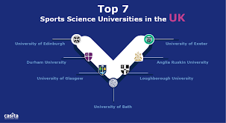

University
Scholarships abroad

Slide 12


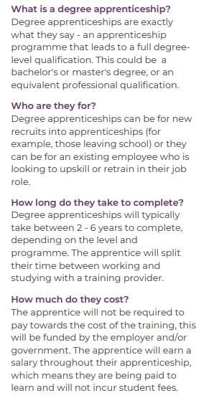
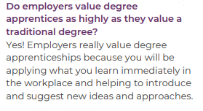

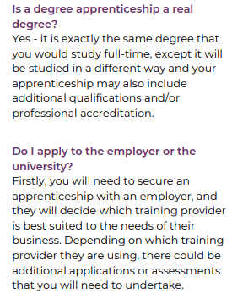

Degree/Higher Level Apprenticeships

Slide 13
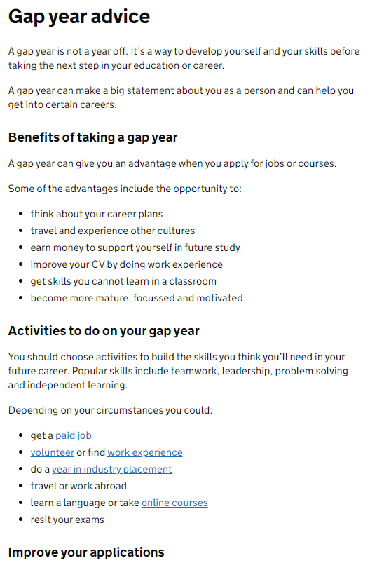

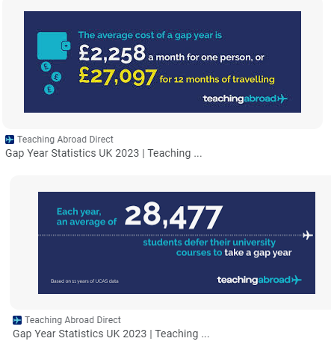
A Gap Year

Slide 14

The World of work

