Slide 1

Signing in to your Unifrog Account

Slide 2

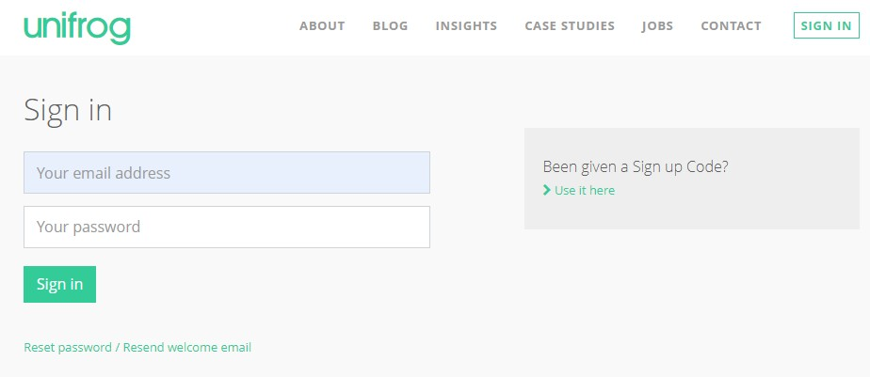
First time sign-up
When you sign in for the first time, you will use a Sign up Code which will link you with your form tutor.
Notes:
Teachers’ notes:
You can find Form Codes in the Your school section on the Teacher side of the platform.
Delete slides 10-11 if students were bulk uploaded.

Slide 3
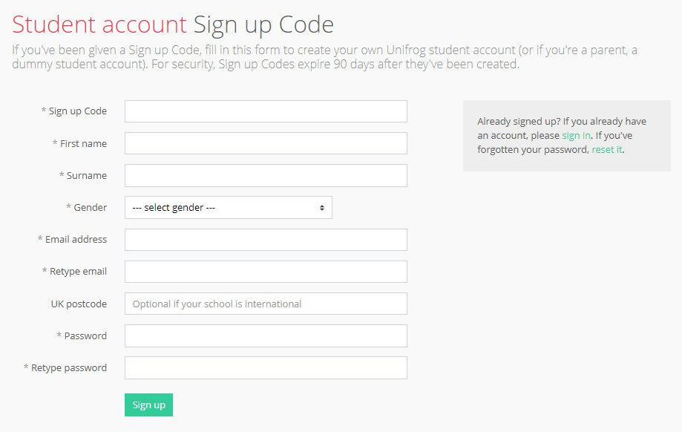
Complete the Sign up page
Completing the Sign up page is simple.
First, put your Sign up Code in.
Use an email address that you access regularly, your home postcode and create a memorable password.

Slide 4
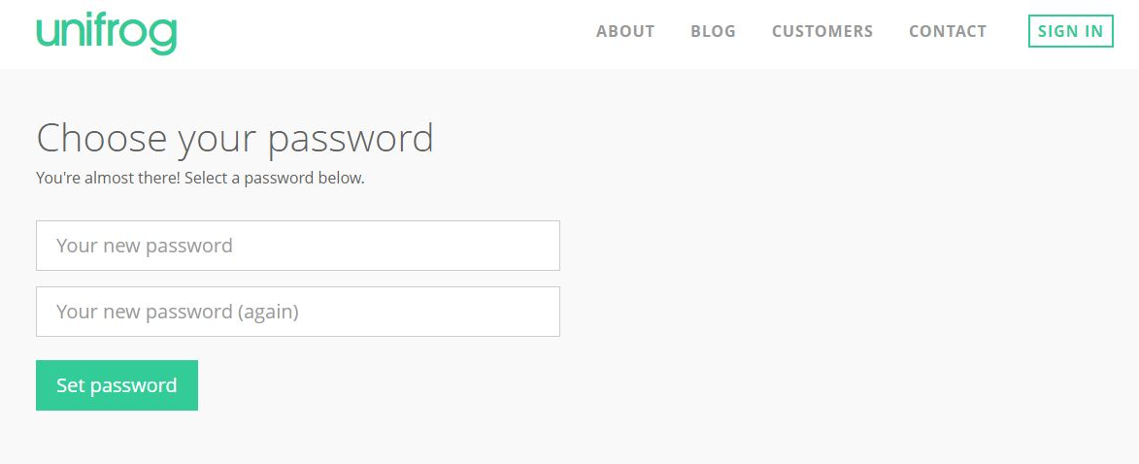
Creating your account
A link has been sent to your school email address (please check your junk/spam mailboxes).
Click the link and follow the instructions.
Create a memorable password and make a note of your password!
Notes:
Teacher’s notes:
Delete this slide (slide 12) if students were uploaded using Sign up Codes.

Slide 5
Access your accounts
Every time you login to Unifrog from now on, sign in using the button in the top right-hand corner of the homepage.
If you do forget your password, hit this link to reset.

Slide 6

Exploring pathways
Recording what you’ve done
Searching for opportunities
Drafting application materials
Making applications
Careers library
Activities
UK universities
UK Personal Statement
Post 16/18 Intentions
Subjects library
Competencies
US universities
Academics
Locker
Know-how library
Interactions
European universities
CV / Resumé
Applications list
MOOC
Oxbridge
Common App Essay
Personality profile
Apprenticeships
US recommenders
Interests profile
College / Sixth Form
Notes for Ref Writers
Canadian universities
Asian universities
Australasian unis
Create an account
Special opportunities
Sign up
ME and African unis
Irish universities

Slide 7


The Careers library allows you to explore different career options by providing information from a range of sources, including interviews with people working within the industry.

Slide 8
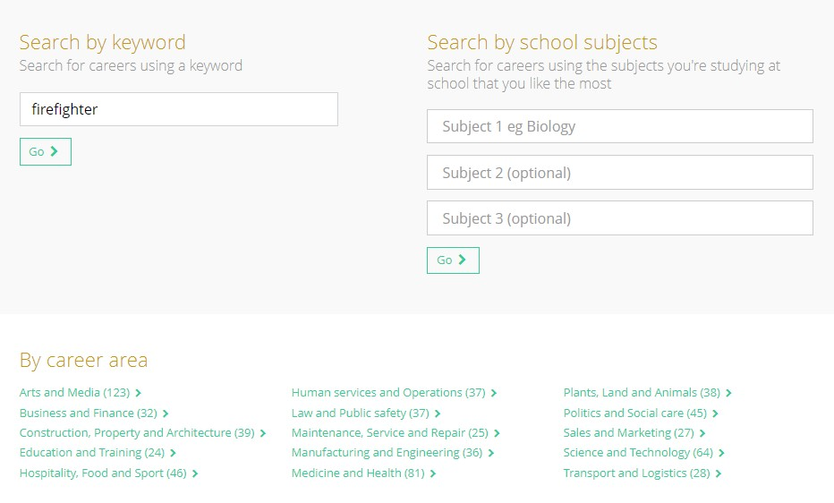
You can search by keyword, school subjects or career area…

Slide 9

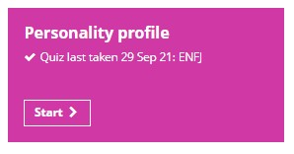
The Personality profile features a personality quiz.
The results of this quiz can then be used to search for careers and university subjects that are associated to your personality type!

Slide 10

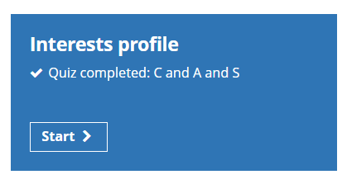
The Interests profile tool features an interests quiz based on Holland’s theory.
The theory is that the careers you’re likely to enjoy will be linked to your personality.
The results of this quiz will help you to explore careers and subjects best-suited to your personality. You might find some that you’ve never thought of before!

Slide 11
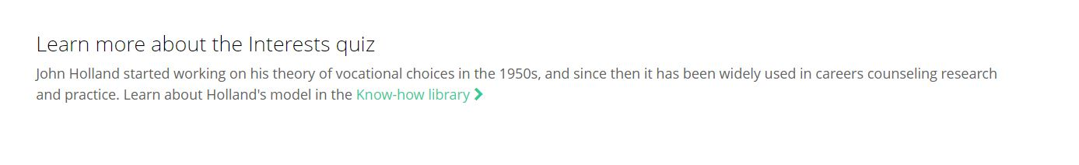
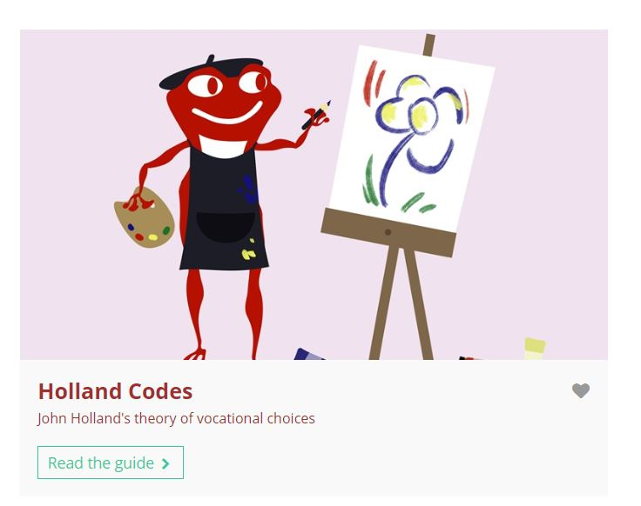
If you would like to find out about the theory behind the Interests quiz, you can click the ‘Know-how library’ link which will take you directly to the guide.
Here, you’re able to read the article explaining the background behind the Holland theory!

Slide 12
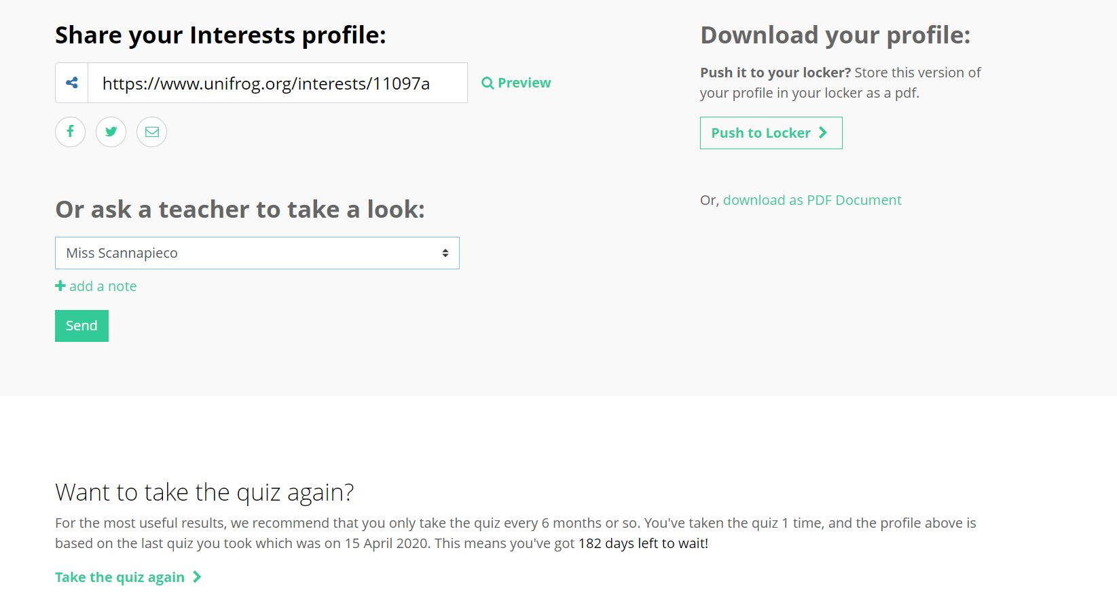
Your Interests profile can be saved as a PDF to be pushed to your Locker, or sent to a teacher.
The quiz can be done as many times as you like, just follow the link at the bottom of the page!

Slide 13
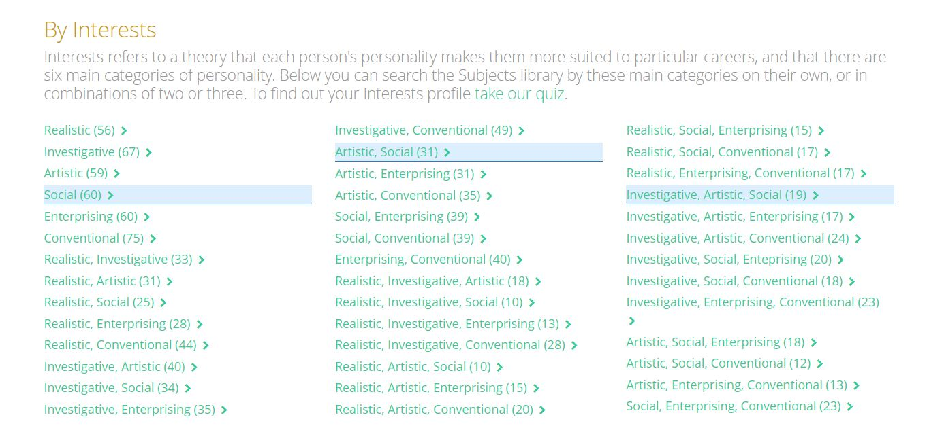
Once you’ve completed the Interests quiz, your personality categories will be highlighted in the Careers and Subject libraries.
Here you can find out more information about the careers and subjects most commonly associated with your personality!

Slide 14
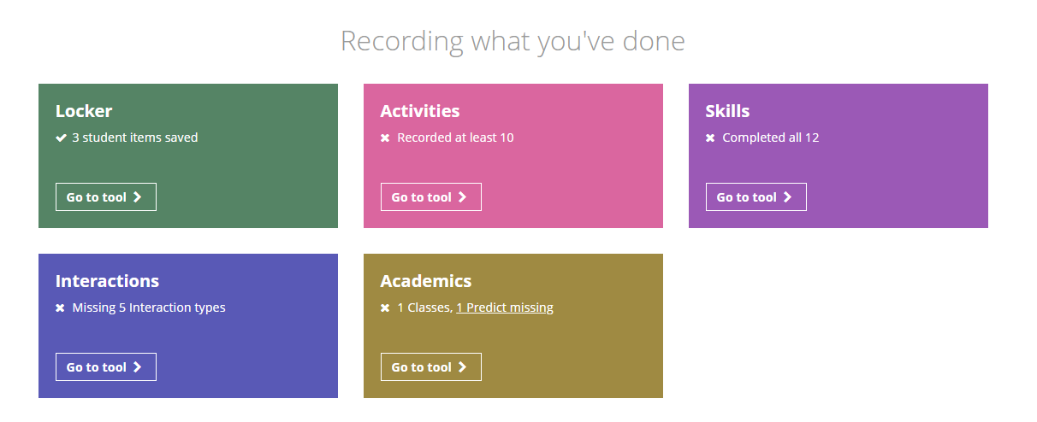
Record your activities and skills now . This will help you build your CV when you need it to apply for jobs .
These show you what has been uploaded for you . Trips, careers Interviews etc.

