Slide 1




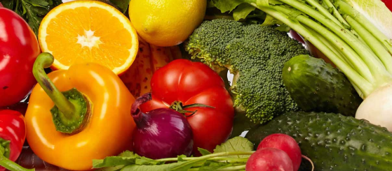















The Balfour Scholars’ Award
(Explained for parents)

Slide 2
What is The Balfour Scholars’ Award?
This Award is aimed at Year 7, 8 and 9 students.
The idea behind the Award is to encourage students to independently carry out tasks which develop their subject knowledge.
The long term gain for students is an improved sense of resilience, determination and perseverance.
The tasks are challenging and have been set by subject teachers.
Completing The Balfour Scholars’ Award will allow students to prove their commitment to excellence.

Slide 3
How do students achieve The Balfour Scholars’ Award?
Follow the steps that are outlined in this PowerPoint to work towards achieving The Balfour Scholars’ Award.
The deadline for all task submissions will be Monday 7th June 2021.

Slide 4
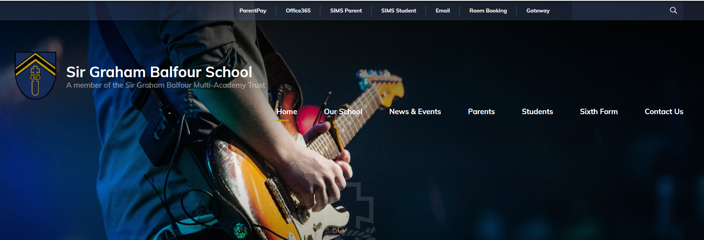
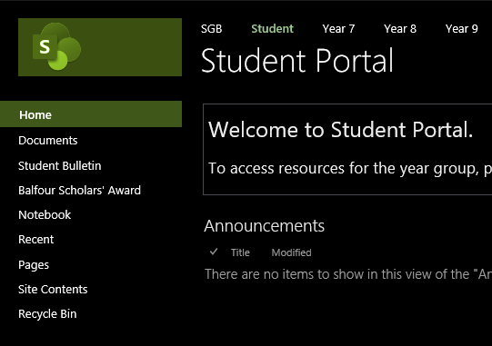
Step 1: log onto the school website and click on the tab at the top called ‘Office 365’ and log in.
Step 2: make sure you click on the student tab. Then down the left hand side you will see The Balfour Scholars’ Award.

Slide 5
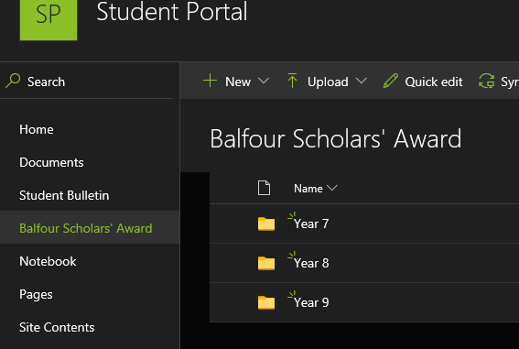
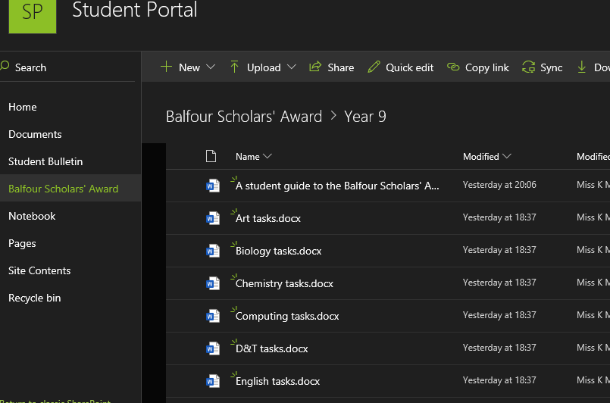
Step 3: click on your year group to find the tasks.
Step 4: click on the document from the subjects you are interested in.

Slide 6
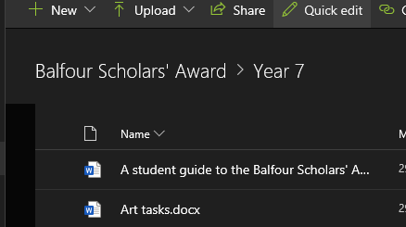
Step 5:
Complete a task as set out by your subject teachers.
Remember, to gain the bronze award you have to complete at LEAST 5 tasks before the deadline (June 2021)
You can complete multiple tasks from one subject area.
However, you should to complete tasks from a mix of subjects.
Step 6: once you have completed a task, send it via email to your subject teacher. If it is outstanding work, then they will forward the work to Miss McConnachie and it will be logged.
Tips for students when sending an email:
State your name clearly.
Make sure you state which year you are in.
Try to be clear about which task you have completed.
Finish the email by thanking your teacher.

Slide 7
Level of Balfour Scholars’ Award
Bronze | 5 tasks
Silver | 10 tasks
Gold | 15 tasks
Platinum | 20 tasks

Slide 8
Examples of some of the tasks available.
Art: Make a concertina sketchbook and make a continuous drawing that evolves and continues across many pages | History: Research Queen Elizabeth I and her reign and answer the question, ‘Why is Queen Elizabeth I’s reign referred to as the Golden Age?’ Your answer should be no longer than 700 words and no less than 500 words. | Geography: How is Cambodia being impacted by deforestation? Research this topic and produce an A3 poster summarising your findings. | English: Write a short story with the title, The Closed Door.
Biology: Research the evolution of the microscope and the impact it has on the present day. Create a report with your findings. | PE: Research a professional athlete and explain why are they successful at what they do. | Headteacher: What is the single most important issue the world needs to address? 1000 word essay. | Maths: Find an origami video on YouTube. Follow the process and bring the finished product to school.
Remember to log onto Office 365 to find the tasks for YOUR year group.

Slide 9
Further examples of some of the tasks available.
D&T: Compare the work of 2 designers of your choice, give examples of their work and state how their designs have contributed to modern day design and technology. | Psychology: Research some of the different branches within Psychology (e.g. clinical, forensic, educational and occupational) and outline the careers associated with each branch. Unifrog could be a great place to start your research. | Music: Research one of the following classical music periods: Baroque, Classical, Romantic, Modern. Create a presentation about it, using your own words that includes information about key composers, instruments and pieces of music in that period. | English: Write your own anthology (collection) of poetry – no less than eight poems. Choose a theme and give the collection a title too.
Physics: Apply ideas about density and upthrust to explain why the Titanic sunk. | Headteacher: If humans still exist in 10,000 years’ time, what will civilisation look like? 1,000 word essay. | PE: Create and label the skeleton of the human body and suggest specific skills from named sports that each bone would be important for. Try not to use the same sport twice if that is possible. | Maths: Write a report on cryptanalysis. Find an example of a famous Mathematician in this area. What impact did their contributions have on society?
Remember to log onto Office 365 to find the tasks for YOUR year group.

Slide 10
Deadline for the Balfour Scholars’ Award 2021
The deadline for all task submissions will be Monday 7th June 2021.
Good luck to everyone taking part!
Any questions? Email Miss McConnachie at kmconnachie@sirgrahambalfour.staffs.sch.uk

